Slide 1
Loops
Overview
In this lesson, students will learn how to iterate over lists or until a condition has been met.
Duration 120 minutes
Learning Objectives
In this lesson, students will:
Use loops to iterate over code blocks repeatedly.
Differentiate between while and for loops.
Use list comprehension to generate lists using loop syntax.

Slide 2
Pre-Class Materials and Preparation
For remote classrooms: Virtual breakout rooms and Slack may be needed to facilitate the partner exercise and discussions. As you plan for your lesson:
Consider how you’ll create pairs for the partner exercise (randomly, or with pre-assigned partners).
Determine how (if at all) exercise timing may need to be adjusted.
For helpful tips, keep an eye out for the For remote classrooms tag in the speaker notes.
Prepare screenshots and answers to exercises in advance so that they can be easily shared in Slack during your lecture.

Slide 3
Pre-Class Materials and Preparation
Pre-Work Review: Many of the concepts covered in this class will recap what students learned in the pre-work; in particular, these myGA lessons:
Control Flow in Python
We recommend reviewing the pre-work lessons to understand what students will come to class knowing. Click here to see the study guides for these lessons. You can also view the pre-work materials on myGA.
For review or extension topics, review the notes in the pre-work for recommendations on how to teach the concept. Leverage the discussions, exercises, and knowledge checks to gauge students’ understanding of concepts. You can adjust your approach to the lesson overall based on how students do with these exercises.

Slide 4
Suggested Agenda
Time | Activity
0:00–0:20 | Welcome + Introduction
0:20–0:50 | While Loops
0:50–1:00 | Break
1:00–1:50 | For Loops
1:50–2:00 | Wrapping Up, Q&A, and Exit Ticket Completion

Slide 5
Jupyter Notebook
The exercises referenced in this lesson can be found in the Python Workbooks + Data folder.
Our first few lessons begin by reviewing the notebook, as the same material was covered in the pre-work.
If students feel that they are able to confidently solve the challenges in the workbook, you can quickly skim through the lesson content and have them only complete the challenges.

Slide 6
Loops

Slide 7
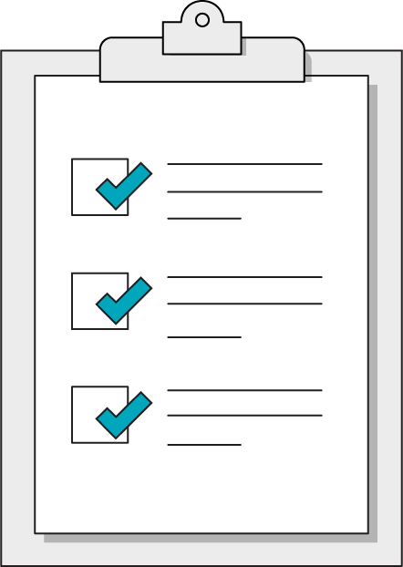
Today’s Learning Objectives
In this lesson, you will:
Use loops to iterate over code blocks repeatedly.
Differentiate between while and for loops.
Use list comprehension to generate lists using loop syntax.
7 | © 2020 General Assembly
Notes:
Purpose: Set expectations for the lesson.
For remote classrooms:
Capture a screenshot of this slide and drop it in the class Slack channel.

Slide 8
What We’ll Practice Today
This class is a blended learning experience. It connects to and reinforces topics that you encountered in the myGA pre-work.
We’re going to return to topics covered in the pre-work and build upon them:
For loops
While loops
Notes:
Purpose: Connect the rest of class to what we’ve already learned in the pre-work.
TALKING POINTS:
We know that you encountered some of what’s in today’s lesson in the pre-work. That’s intentional! We use a blended learning approach that incorporates myGA, assessments, and in-class lessons. They all work together to help you succeed in the course and let us know where you’re coming from.
We don’t want to bore you with stuff you already know, but we also don’t want to skip over really crucial topics. We’ll use discussions and exercises to make sure we’re going at your speed when it comes to familiar topics, as well as the new ones.
The pre-work helps you come into the classroom with a solid, foundational understanding of the basics. We’re going to practice and reinforce those topics and then start to build upon them.

Slide 9
Jupyter Notebook Review
10 minutes
Let’s dive right in and use what we learned in the pre-work! We want to understand where you are in your learning journey so that we can give the best possible experience in class.
Look over the exercises in today's Jupyter Notebook and attempt any that seem immediately doable to you.
Then, rate your confidence level on today's subjects from 1–5.
Notes:
Purpose: Understand how much students have retained from the pre-work lessons.
TEACHING TIPS:
This exercise will help you gauge where students are in terms of how much they retained from the pre-work so that you can appropriately adjust the rest of the lesson/future lessons.
Remind students that we're not asking them to complete all questions immediately. Note that, if they are struggling, we’ll recap how to write each of them in this and the following lesson.
For remote classrooms:
Ask students to rate their confidence in this subject using Slack response emojis 1–5, or a quick anonymous poll. If ALL students feel confident in this subject, feel free to skip through the actual lesson slides and dive right into the exercises in the notebook.

Slide 10
Life Without Loops
Imagine that we have a list of colors and we want to print each one:
colors = ["red", "orange", "yellow"]
print(colors[0])
print(colors[1])
print(colors[2])
Does this seem sustainable?
Notes:
Purpose: Review the importance of loops.
TEACHING TIPS:
Introduce the “Don't repeat yourself” mantra.
This pattern will take all day, require constant updating if the list changes, and clog our program with endless copies of the same line.
Not to mention, there’s an increased chance for typos!

Slide 11
Loop: A control flow statement allowing for the repeated execution of a code block until a specific condition is reached.
11 | © 2020 General Assembly
Notes:
Purpose: Review the importance of loops.
TEACHING TIPS:
This should be a review of what students saw in the pre-work.

Slide 12
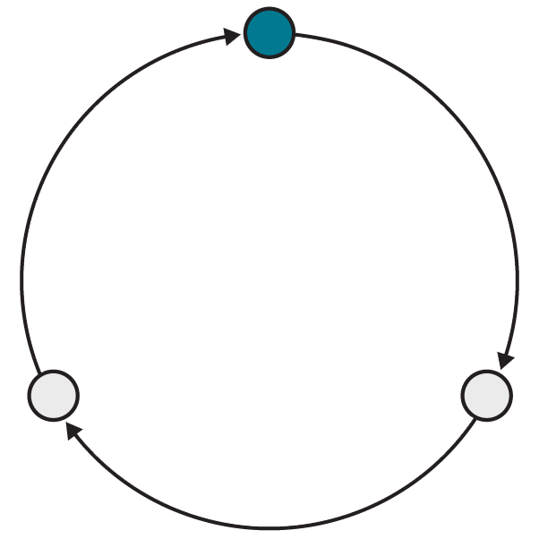
Why Loops?
Loops take advantage of what computers do best: evaluate instructions across organized sets of data very quickly.
Computers excel when working in isolated patterns, which is exactly how a loop works.
You can avoid needlessly copying or re-typing code by repeating it in a loop.
Notes:
Purpose: Review the importance of loops.
TEACHING TIPS:
This should be a review of what students saw in the pre-work.
You can also mention the problem with lists of data coming from databases/other web apps — we have no idea how many there will be, so we can’t hard-code our operations in a giant copy-paste stack, even if we wanted to. We can use len()and loops, however!

Slide 13
While Loops
Loops
Notes:
Duration: 30 minutes

Slide 14
while Loop
A while loop is very straightforward. It continues executing while the condition you've given it is still true. Once the condition is false, it stops!
number = 0
while number < 10:
number = number + 1
print(number)
Notes:
Purpose: Review while loops.
TEACHING TIPS:
This should be a review of what students saw in the pre-work.

Slide 15
What Will This Code Do?
number = 1
while number > 0:
number = number + 1
print(number)
Notes:
Purpose: Review while loops.
TEACHING TIPS:
This should be a review of what students saw in the pre-work.
Encourage students to think it through and keep track of the value of the number, reinforcing the concept of going "back to the top" of the condition and evaluating before continuing. It's an infinite loop!

Slide 16
Caution! Infinite Loops Ahead
Be careful with while loops! If the condition is never broken, you'll have an unending loop that will devour your computer's processing power.
number = 1
while number > 0:
number = number + 1
print(number)
Notes:
Purpose: Review while loops.
TEACHING TIPS:
This should be a review of what students saw in the pre-work.

Slide 17
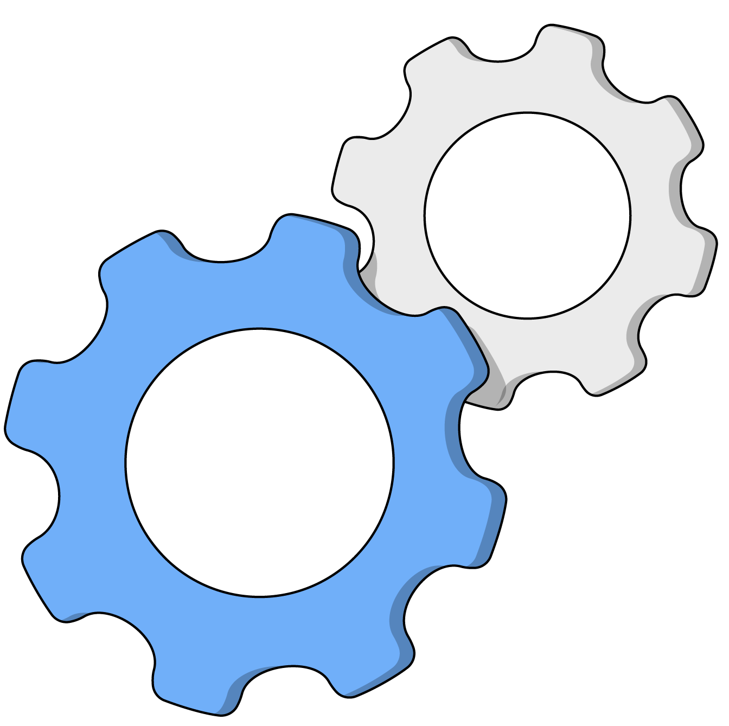
4.1 While Loops
20 minutes
Use while loops to complete the challenges in Section 4.1 of the Jupyter Notebook.
Notes:
Purpose: Practice writing while loops.
TEACHING TIPS:
This should be a review of what students saw in the pre-work.
If you’d like, you can complete the first challenge yourself as a demo and get the ball rolling on this exercise.

Slide 18
For Loops
Loops
Notes:
Duration: 50 minutes

Slide 19
For Loop
A for loop is geared more toward iterating over lists or collections of data:
Define a variable to act as our iterator.
Provide the iterable value, typically a list.
for number in [0,1,2,3,4,5]:
print(number)
# outputs 0,1,2,3,4,5
Notes:
Purpose: Review for loops.
TEACHING TIPS:
This should be a review of what students saw in the pre-work.
This is a good opportunity to break down how this loop would operate with a cross-chart; much like a manual debugger, track numbers’ value and talk through the steps out loud as you go.

Slide 20

The Naming of Things
Remember, clear naming and syntax are one of Python’s great advantages. Don’t spoil it by naming your iterator something vague — be descriptive!
# x is not descriptive!
colors = ["red","yellow"]
for x in colors:
print(x)
# color is more accurate
colors = ["red","yellow"]
for color in colors:
print(color)
Notes:
Purpose: Review for loops.

Slide 21

4.2 For Loops
15 minutes
Let's practice some for loops by looping over a list of numbers in Section 4.2 of the workbook.
Notes:
Purpose: Practice writing for loops.
TEACHING TIPS:
This should be a review of what students saw in the pre-work

Slide 22
Using the range() Function
Because for loops require an iterable, it's common to use the range() function to automatically generate a list of numbers over which to iterate.
for number in range(6):
print(number)
# outputs 0,1,2,3,4,5
# why isn't 6 included in the output?
Notes:
Purpose: Introduce range().

Slide 23
The Many Faces of range()
 | Explanation | Example
One parameter | A list from zero up to, but not including, the given number. | range(5) [0,1,2,3,4]
Two parameters | A list including the first number, up to, but not including, the second number. | range(5, 10) [5,6,7,8,9]
Three parameters | A list from the first number up to, but not including, the second number, increasing (or "striding") by the third number. | range(1,10,2) [1,3,5,7,9]
Notes:
Purpose: Introduce range().

Slide 24
Looping With Indices
If you want to actually modify a list while looping, you must use indices:
numbers = [1,2,3,4]
list_length = len(numbers)
for i in range( len(list_name) ):
numbers[i] = numbers[i] * 2
Notes:
Purpose: Introduce how to use range() to modify a list.
TEACHING TIPS:
Unpack what's going on here and why the range() function makes perfect sense for looping over lists.
You might note that a simple for number in numbers is assigning a shallow copy that doesn't refer back to the original list.

Slide 25
Looping Over Dictionaries
Dictionaries have an .items() method to help loop through keys and values.
author = { "first_name": "Kazuo", "last_name": "Ishiguro" }
for key, value in author.items():
print(value)
Notes:
Purpose: Introduce looping over dictionaries.
TEACHING TIPS:
Explain as much or as little about how the .items() method works as seems appropriate.
You can mention the output of the .items() method or introduce tuple unpacking, although neither are necessary at this time.

Slide 26
Nested Loops
Just as it’s possible to nest data structures inside of each other, it is also possible to put loops inside of other loops.
for num_one in range(1,13):
for num_two in range(1,13):
print(f"{num_one} times {num_two} = {num_one * num_two}")
Notes:
Purpose: Introduce nested loops.
TALKING POINTS:
While nested loops are sometimes necessary, this will result in increased complexity, both for you as a programmer and for the computer while executing the program.

Slide 27
For vs. While: Which One to Use?
While Loops
For Loops
Great for instances when you have no way of knowing how many times you need to iterate.
Useful for things like random chance or eliminating specific items of an undetermined amount.
The most common loops, used when you know exactly how many times you need to iterate.
If you have a list and need to look through every item, use a for loop.
vs.
Notes:
Purpose: Compare use cases for while and for loops.

Slide 28
For or While?
Look through a list to find the largest number.
Flip a coin until heads shows up three times in a row.
Print every value in a list.
Animate a game screen until the player's health is zero.
Check the weather every five seconds until it rains.
Notes:
Purpose: Have students evaluate use cases for while and for loops.
TEACHING TIPS:
Answers:
For
While
For
While
While

Slide 29
List Comprehension
Here’s a neat trick for creating new lists using a loop-like syntax:
numbers = [1,2,3,4,5]
even_numbers = [ num * 2 for num in numbers ]
# even_numbers is [2,4,6,8,10]
Notes:
Purpose: Introduce list comprehension.
TALKING POINTS:
List comprehension is very common in data analysis applications, and it's important to be able to read the syntax in the examples you'll come across.

Slide 30
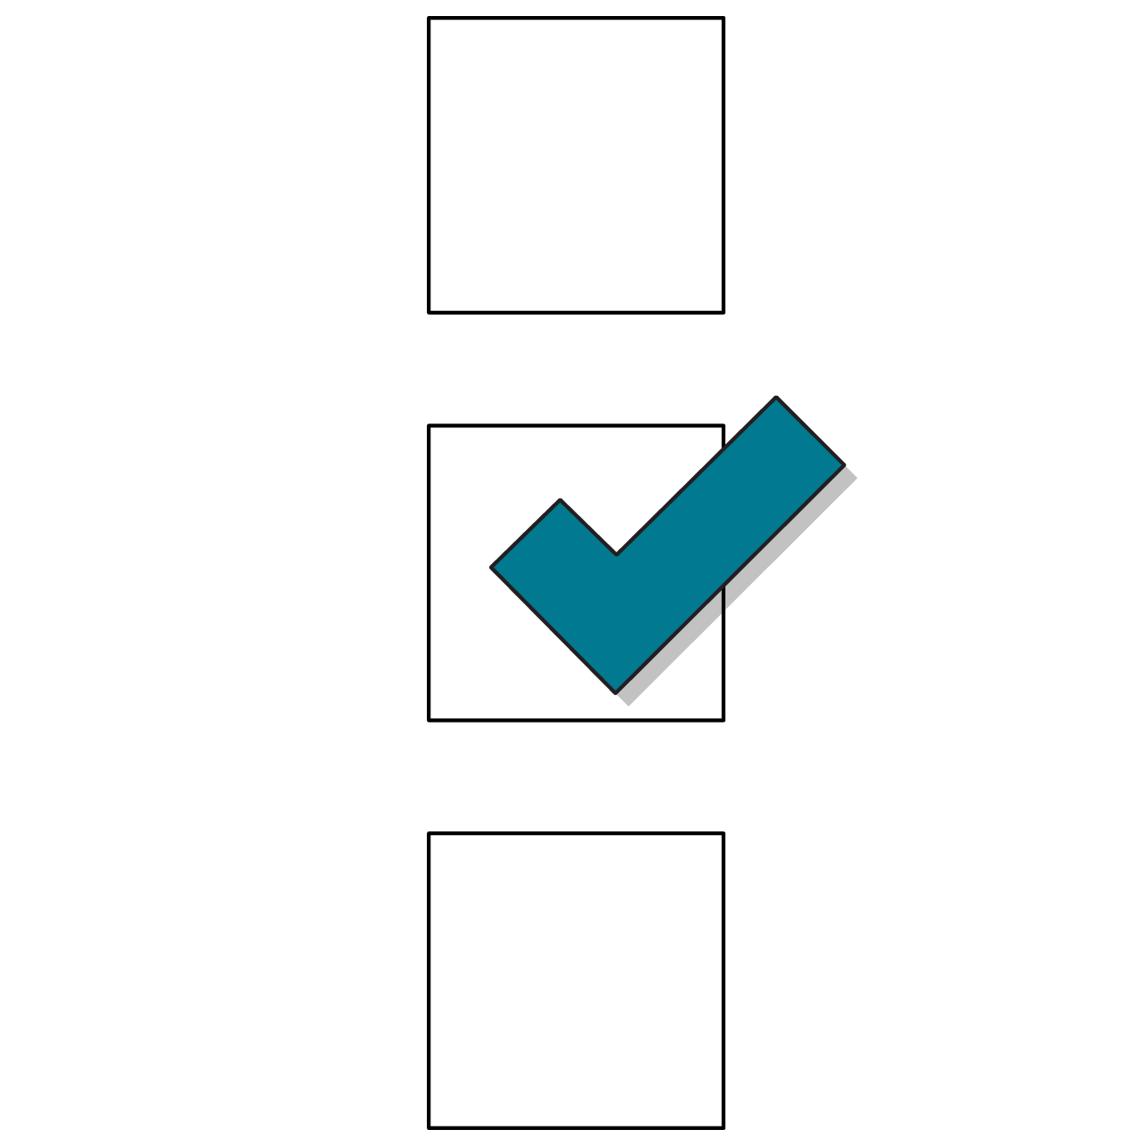
4.3 List Comprehension
20 minutes
Shortcuts like list comprehension are what make experienced programmers fall in love with Python.
Let’s try out some challenges using list comprehension instead of loops in Section 4.3 of the workbook.
Notes:
Purpose: Give students practice with list comprehension.

Slide 31
4.4 Hold on to Your Loops
30 minutes
Things can start getting complicated now that we have loops, conditionals, and data structures!
The challenges in Section 4.4 will be tough, so be sure to lean on print statements to help navigate your way through these tasks one step at a time.
Notes:
Purpose: Help students put together control flow with loops and conditionals as well as data structures.

Slide 32
Wrapping Up
Loops
Notes:
Duration: 10 minutes

Slide 33
Recap
Looking Ahead
In today’s class, we…
Used loops to iterate over code blocks repeatedly.
Differentiated between while and for loops.
Used list comprehension to generate lists using loop syntax.
On your own:
Ensure that you’ve completed the Python pre-work and pre-work quiz.
Next Class:
Functions
Notes:
Purpose: Recap what was covered in the lesson.

Slide 34

Don’t Forget: Exit Tickets!

